Slide 1

AI / GENAI POWERED CYBERSECURITY · CAPSTONE PROJECT
CloudGuardian
AI-Assisted Cloud Security Posture Management on Microsoft Azure & AWS
Executive Briefing
Deck-driven readout · 15 -20 minutes
Presented by Kedar Pavaskar, Vinay Kumar & Megha Sharma - Team CyberSentinel IIT Roorkee × Futurense · Cloud Security Essentials Track
Notes:
PURPOSE: Set an executive, consulting register before a word is spoken. TALKING POINTS: This is a briefing on a CSPM capability, not a lab walkthrough; no live demo - the deck itself is the evidence. NARRATION: "Good morning. Over the next fifteen minutes I'll brief you on CloudGuardian - an AI-assisted cloud security posture management capability built end-to-end on Microsoft Azure. Everything you'll see is drawn from a working system." TRANSITION: "Let me start where every steering committee wants to start - the bottom line." LIKELY Q: None expected at title.

Slide 2




01 · THE BUSINESS PROBLEM
Executive Summary
What we built, what it found, and what it is worth - in one view.
BUILD & BREAK
real Azure workload, 16 controlled flaws
DETECT
3 independent CSPM scanners, one schema
DECIDE
risk-scored + AI-explained, human-gated
REMEDIATE
safe auto-fix, ISO 27001 traceable
16
83
68
ISO 27001 + CIS + DPDP
controlled misconfigurations
(2× individual-track minimum)
Prowler findings
against the broken baseline
confirmed FAILs
triaged, scored & governed
every control mapped
to a named Annex A clause
KEY MESSAGE A continuous detect → prioritize → explain → remediate loop, proven achievable at individual, free-tier scale.
CloudGuardian · CSPM Executive Briefing
01 · The Business Problem
02
Notes:
PURPOSE: Give the whole story away up front - consulting decks never bury the lede. TALKING POINTS: Four capabilities, four hard numbers. 16 deliberate flaws (double the bar), 83 findings / 68 FAILs detected, all mapped to ISO 27001. NARRATION: "Here is the entire engagement on one slide. We deliberately broke a real Azure environment sixteen ways, detected it with three independent tools producing 83 findings and 68 confirmed failures, prioritized and explained them with AI that we verified, auto-remediated the safe fixes, and gated the risky ones behind human approval - every control traceable to ISO 27001." TRANSITION: "To see why this matters, start with the business problem it was built to solve." LIKELY Q: "Is this AWS too?" - Azure is the deployed system of record; the pipeline is cloud-agnostic by design (slide 21).

Slide 3








01 · THE BUSINESS PROBLEM
Why Manual Review Fails at Cloud Scale
A point-in-time audit is stale the day it is published.
Where This Sits: CSPM → CNAPP
THE DRIFT GAP
CloudGuardian is the extensible core of the platform the market is converging on.
CIEM
CIEM
CSPM - the foundation we built
Audit
sign-off
Config
change
Config
change
Drift
unseen
Breach
window
Detect & fix misconfiguration and compliance drift
CIEM - identity entitlements
Workload / CWPP
CSPM
CORE
DSPM
Right-size who can do what across the estate
Snapshots age instantly
DSPM - data-aware risk
A quarterly review reflects a cloud that no longer exists
Prioritize by the sensitivity of exposed data
Attack-path analysis
Change outpaces people
CNAPP
Chain findings into real exploit routes
Hundreds of daily changes; humans sample a handful
Direction of travel - CloudGuardian's schema-first design extends outward without re-architecture.
Alert fatigue buries signal
Raw scanner output without prioritization is ignored
Attack Path
KEY MESSAGE Continuous, automated, prioritized detection is the only viable operating model - not a nice-to-have.
CloudGuardian · CSPM Executive Briefing
01 · The Business Problem
03
Notes:
PURPOSE: Justify automation and prioritization as the correct solution shape before introducing CloudGuardian. TALKING POINTS: Snapshots age instantly; change outpaces human review; raw un-prioritized output causes alert fatigue. NARRATION: "A manual audit is a photograph of a moving car. By the time it's written up, the estate has changed hundreds of times. And simply pointing more scanners at the problem makes it worse - un-prioritized noise gets ignored. The answer has to be continuous, automated, and ranked." TRANSITION: "That operating model is exactly what CloudGuardian was built to deliver." LIKELY Q: "Doesn't Defender do this already?" - Yes in part; we integrate that thinking and add multi-tool triangulation, custom prioritization and governed remediation (covered later).

Slide 4




02 · ARCHITECTURE & TECHNOLOGY
Overall Solution Architecture
A closed loop, not a collection of scripts - every later slide zooms into one box here.
Azure/AWS
Workload
CSPM
Scanners
Canonical
Findings
Prioritize
+ Explain
Approval
Dashboard
Remediate
+ Audit
3-tier target
Prowler · Scout · Steampipe
one schema
score + AI
human gate
safe fix + log
continuous re-scan loop
Detect → decide → remediate → re-verify runs as a loop, not a one-off scan
Schema boundary in the middle makes the whole pipeline cloud-agnostic
Design Principles
Cloud-agnostic by design
Safe by default
One canonical schema; Azure and AWS findings are plug-compatible with zero downstream change.
Every misconfiguration toggle defaults to the secure setting - insecurity must be switched on deliberately.
Human governs the irreversible
Verify before trust
Anything risky or non-reversible stops at an explicit human approval gate with full audit.
No AI output reaches an operator until it is checked against raw scanner evidence.
CloudGuardian · CSPM Executive Briefing
03 · Architecture & Technology
05
Notes:
PURPOSE: The single most important visual - the whole system end-to-end on one page. It is the map the audience references for the rest of the talk. TALKING POINTS: Six stages - workload, scanners, canonical findings, prioritize+explain, approval dashboard, remediate+audit - connected as a continuous loop. NARRATION: "This is the entire system on one page. A real Azure workload is scanned by three tools; findings normalize into one canonical store; they're scored and explained; an analyst approves or rejects in a dashboard; safe fixes are applied and everything is logged - then it re-scans. Every slide that follows is a zoom into one of these boxes." TRANSITION: "Let's start at the left - the workload itself." LIKELY Q: "Where does Azure-native Defender fit?" - as a complementary read-only signal source into the canonical store; our pipeline is tool-agnostic.

Slide 5




02 · ARCHITECTURE & TECHNOLOGY
Cloud Agnostic Workload Architecture
A real 3-tier environment - the findings that follow are meaningful, not toy.
RESOURCE GROUP · rg-cloudguardian-lab · Central US
Provisioned by Terraform
Virtual Network / VPC · web + data subnets · NSG / Security Group
11-file modular IaC project
Web Tier
Ubuntu VM · Public IP · nginx
Mirrors enterprise shape
Log Analytics Workspace
/ CloudWatch Logs
Data Tier
Segmented tiers, real services
Azure SQL Database / Amazon RDS (Basic)
Storage
diagnostics sink
Secure-by-default baseline
Storage Account / Amazon S3 + container
Flaws are toggled, not native
Technology Stack
Infrastructure-as-Code
Terraform (Azure + AWS provider)
CSPM Detection
Prowler
ScoutSuite
Steampipe + CIS mod
Cloud-Native (read-only signal)
Defender for Cloud / Security Hub
Secure Score / Security Hub Score
Resource Graph / Config
Intelligence Layer
Python + pandas
LLM API (verified)
Governance Console
Streamlit
SQLite
Plotly
Automation
PowerShell / AWS CLI
Functions & Logic Apps / Lambda & Step Functions (target)
CloudGuardian · CSPM Executive Briefing
03 · Architecture & Technology
13
Notes:
PURPOSE: The single most important visual - the whole system end-to-end on one page. It is the map the audience references for the rest of the talk. TALKING POINTS: Six stages - workload, scanners, canonical findings, prioritize+explain, approval dashboard, remediate+audit - connected as a continuous loop. NARRATION: "This is the entire system on one page. A real Azure workload is scanned by three tools; findings normalize into one canonical store; they're scored and explained; an analyst approves or rejects in a dashboard; safe fixes are applied and everything is logged - then it re-scans. Every slide that follows is a zoom into one of these boxes." TRANSITION: "Let's start at the left - the workload itself." LIKELY Q: "Where does Azure-native Defender fit?" - as a complementary read-only signal source into the canonical store; our pipeline is tool-agnostic.

Slide 6


03 · CSPM TOOLING
Why Three Scanners, Not One
Triangulation is how real teams drive down false negatives.
Prowler
ScoutSuite
Steampipe
Primary - breadth
Independent cross-check
SQL + CIS benchmark
Widest check coverage
CSV / HTML / JSON-OCSF output
83 findings on our baseline
Second opinion on findings
Different detection engine
Reduces single-tool blind spots
Query findings as SQL
Azure CIS compliance mod
Benchmark-native validation
COMBINED FINDINGS
AZURE PATH
Event Grid
Logic App
Function App
event router
approval gate
auto-remediate
Normalize
Prioritize
merge 3 scanner outputs
risk score + LLM
EventBridge
Step Functions
Lambda
event router
approval gate
auto-remediate
AWS PATH
KEY MESSAGE No single scanner is trusted blindly - agreement across tools raises confidence; disagreement surfaces gaps.
CloudGuardian · CSPM Executive Briefing
03 · Architecture & Technology
06
Notes:
PURPOSE: Turn a tooling choice into demonstrated security-engineering judgment. TALKING POINTS: Prowler for breadth (83 findings), ScoutSuite as an independent second opinion, Steampipe for SQL querying and CIS-benchmark-native validation. NARRATION: "One scanner has blind spots. So we ran three with different engines: Prowler for breadth, ScoutSuite as an independent cross-check, and Steampipe to query findings as SQL against the CIS benchmark. Where they agree, confidence is high; where they diverge, that divergence is itself a signal." TRANSITION: "Now the core of the work - how we broke, detected, reasoned about, and governed this environment." LIKELY Q: "ScoutSuite maintenance?" - aware it's been lightly maintained since 2024; used as corroboration, not sole source - exactly why three tools.

Slide 7



04 · IMPLEMENTATION - BREAK · REASON · GOVERN
Findings Consolidation: One Canonical Schema
The decision that makes the entire pipeline cloud-agnostic.
Prowler
CSV / JSON-OCSF
ScoutSuite
JSON
Prioritization engine
AI explanation layer
Normalization
(data_loader)
Steampipe
SQL rows
canonical schema
Approval dashboard
Azure ▸ AWS plug-in
Prioritization Engine
Turning 68 raw failures into a ranked, defensible backlog.
×
×
=
PRIORITY
SCORE
CVSS
Exposure
Blast Radius
single, sortable value
Technical severity
Internet-facing vs internal
What else it touches
WORKED EXAMPLE - top of the backlog
Public SQL firewall (internet-facing DB)
95
Public storage container
88
SSH open to 0.0.0.0/0
74
Diagnostics disabled (internal)
41
KEY MESSAGE Add a new cloud by adding a conforming CSV - zero downstream code changes. That is platform thinking.
CloudGuardian · CSPM Executive Briefing
04 · Implementation - Break · Reason · Govern
07
Notes:
PURPOSE: Resolve the Azure/AWS scope question by reframing it as a deliberate platform-engineering strength. TALKING POINTS: Three raw formats normalize into one canonical schema; every downstream consumer reads only that schema; adding AWS is adding a conforming CSV. NARRATION: "Three tools produce three formats. Rather than special-casing each downstream, we normalize everything into one canonical schema. The prioritizer, the AI layer and the dashboard only ever see that schema - which means Azure and AWS findings are plug-compatible. Adding a second cloud is adding a conforming file, not re-architecting." TRANSITION: "Once findings are uniform, we can rank them honestly - the prioritization engine." LIKELY Q: "So is AWS live?" - Azure is the deployed system of record; AWS is proven schema-compatible with a sample dataset and is the immediate roadmap step.

Slide 8
04 · IMPLEMENTATION - BREAK · REASON · GOVERN
How RAG Grounds the Prioritization Engine
Every remediation suggestion is traced to a cited compliance control, not the model’s memory. (week2_prioritization_Rag_updated.ipynb)
1
Knowledge Base
PIPELINE PARAMETERS
25 control-guidance chunks from CIS, MCSB, ISO 27001, DPDP Act, and HIPAA - each citing a source URL.
KNOWLEDGE BASE
CONTROL_KB
25 chunks · 6 frameworks
2
Hybrid Retrieval Index
CIS · MCSB · ISO 27001 Annex A · DPDP Act 2023 · HIPAA
TF-IDF (0.4) for exact terms + NVIDIA NIM embeddings (0.6) for semantic matches, scoped by cloud + service.
nvidia/nv-embedqa-e5-v5
HYBRID RETRIEVAL WEIGHTS
3
Retrieval
Finding title + detail becomes the query; the top-1 matching control is retrieved from the scoped pool.
TF-IDF 0.4
Embeddings 0.6
top_k = 1
4
Grounded Generation
GENERATION MODEL
Retrieved control text grounds the system prompt - the LLM paraphrases it into exactly 2 lines, no invented facts.
meta/llama-3.1-8b-instruct
meta/llama-3.1-8b-instruct
via NVIDIA NIM
5
Semantic Verification
Guidance embedding is compared to the retrieved control's embedding; low-similarity matches are flagged for review.
VERIFICATION GATE
cosine similarity ≥ 0.55
cosine similarity ≥ 0.55
6
Audit Trail
Below threshold → flagged REVIEW, not auto-published
Control reference, framework, source URL, and similarity score are logged to CSV for every finding.
rag_retrieval_audit.csv
CloudGuardian · CSPM Executive Briefing
04 · Implementation - Break · Reason · Govern
08
Notes:
PURPOSE: Resolve the Azure/AWS scope question by reframing it as a deliberate platform-engineering strength. TALKING POINTS: Three raw formats normalize into one canonical schema; every downstream consumer reads only that schema; adding AWS is adding a conforming CSV. NARRATION: "Three tools produce three formats. Rather than special-casing each downstream, we normalize everything into one canonical schema. The prioritizer, the AI layer and the dashboard only ever see that schema - which means Azure and AWS findings are plug-compatible. Adding a second cloud is adding a conforming file, not re-architecting." TRANSITION: "Once findings are uniform, we can rank them honestly - the prioritization engine." LIKELY Q: "So is AWS live?" - Azure is the deployed system of record; AWS is proven schema-compatible with a sample dataset and is the immediate roadmap step.

Slide 9
04 · IMPLEMENTATION - BREAK · REASON · GOVERN
Event-Driven Remediation Architecture
Low / Medium severity
Function App
advanced filter: data.severity
auto_remediate (Event Grid trigger)
CSPM Findings
Event Grid Topic
Week 2 pipeline
evgt-cloudguardian-findings
High / Critical severity
Logic App
advanced filter: data.severity
human approval (ACS Email)
Log Analytics
Target Azure Resources
6 Remediation Modules
Function App
audit trail (KQL)
Storage / SQL / Key Vault
shared dispatcher
execute-remediation (HTTP, post-approval)
Automation Account (daily): re-checks all 6 controls, flags drift without silently re-fixing
CloudGuardian · CSPM Executive Briefing
04 · Implementation - Break · Reason · Govern
09
Notes:
PURPOSE: Resolve the Azure/AWS scope question by reframing it as a deliberate platform-engineering strength. TALKING POINTS: Three raw formats normalize into one canonical schema; every downstream consumer reads only that schema; adding AWS is adding a conforming CSV. NARRATION: "Three tools produce three formats. Rather than special-casing each downstream, we normalize everything into one canonical schema. The prioritizer, the AI layer and the dashboard only ever see that schema - which means Azure and AWS findings are plug-compatible. Adding a second cloud is adding a conforming file, not re-architecting." TRANSITION: "Once findings are uniform, we can rank them honestly - the prioritization engine." LIKELY Q: "So is AWS live?" - Azure is the deployed system of record; AWS is proven schema-compatible with a sample dataset and is the immediate roadmap step.

Slide 10


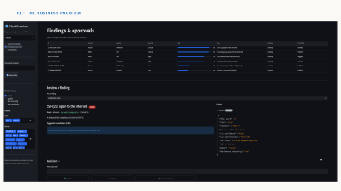
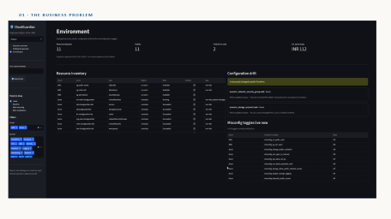
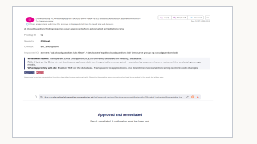
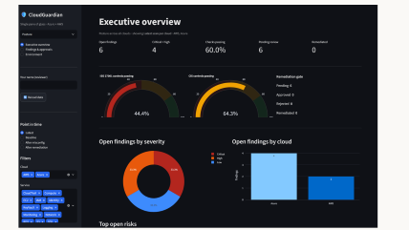
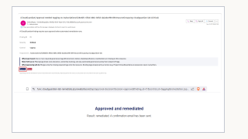
04 · IMPLEMENTATION - BREAK · REASON · GOVERN
Human-in-the-Loop Governance Console
The control surface a real security team would actually operate.
Overview
Findings & Approvals
Audit Trail
Posture at a glance - counts, severity mix, tool agreement
Ranked findings; approve or reject each remediation
Ranked findings; approve or reject each remediation
Immutable record of every decision and action
CloudGuardian · CSPM Executive Briefing
04 · Implementation - Break · Reason · Govern
10
Notes:
PURPOSE: Visual proof point for the human-approval gate (rubric auto-remediation criterion). TALKING POINTS: Three-page Streamlit console - Overview, Findings & Approvals, Audit Trail - reading the canonical schema; SQLite persistence. NARRATION: "Findings and AI guidance land here - a three-page operator console. Overview gives posture at a glance; Findings and Approvals is where an analyst ranks through and approves or rejects each fix; Audit Trail records every decision. This is the surface that keeps a human firmly in control." TRANSITION: "When a human approves, what actually happens is governed by risk - the remediation logic." LIKELY Q: "Why Streamlit not a portal add-in?" - fastest path to a working operator console; the schema-first design means the UI is swappable.

Slide 11
05 · CONTROLS & FRAMEWORK ALIGNMENT
Multi-Framework Compliance Crosswalk
Direct traceability from CloudGuardian controls to ISO 27001, CIS Benchmarks, and India’s DPDP Act 2023.
CloudGuardian Control | ISO 27001 Annex A | CIS Benchmark | DPDP Act / Rules 2025 | Control Objective
Storage · public access | A.5.10 | CIS 3.1 / 3.3 | Sec 8(5) Safeguards | Acceptable use / protection of information
IAM · over-privilege | A.5.15 / A.5.18 | CIS 1.1 / 5.4 | Sec 8(5) Access Control | Access control · access rights
Encryption at rest | A.8.24 | CIS 4.1 / 3.11 | Rules 2025 Sch. (Encryption) | Use of cryptography
Networking · exposure | A.8.20 / A.8.22 | CIS 6.1 / 12.1 | Sec 8(5) Network Security | Network security · segregation
Logging & diagnostics | A.8.15 | CIS 5.1 / 8.2 | Rules 2025 (1-Yr Logs) | Logging
Remediation governance | A.5.1 / A.8.16 | CIS 18.1 / 18.3 | Sec 8 Accountability | Policies · monitoring activities
Team-mode scope: every control maps to ISO 27001 Annex A, the relevant CIS Benchmark, and DPDP Act 2023 / Rules 2025.
CloudGuardian · CSPM Executive Briefing
05 · Controls & Framework Alignment
11
Notes:
PURPOSE: Deliver the rubric's explicit compliance-mapping requirement (ISO 27001 accuracy). TALKING POINTS: Each control category maps to specific Annex A references - access control, cryptography, network security, logging, monitoring. NARRATION: "This is the slide the client cares about most. Every control category maps to a specific ISO 27001 Annex A clause - storage exposure to acceptable-use, IAM to access control, encryption to cryptography, logging to A.8.15. This isn't 'best practice' hand-waving; it's traceable to the exact standard they keep failing." TRANSITION: "ISO says what good looks like; CIS benchmarks say exactly how to configure it - validated by Steampipe." LIKELY Q: "Annex A version?" - ISO/IEC 27001:2022 Annex A control identifiers; DPDP mapping is a documented stretch.

Slide 12

06 · RESULTS & BUSINESS VALUE
Before vs After: Security Posture
Concrete, numeric proof the pipeline changes posture - not just reports on it.
68→12
~ 82%
open findings after
end-to-end remediation
reduction in open
misconfigurations
WHAT REMAINS
The residual 12 are risk-classified and held at the human-approval gate - visible, ranked and governed, not silently open.
Illustrative remediation trajectory from the governed pipeline; baseline = 68 confirmed FAILs.
Security Maturity Progression
From reactive audit failure toward managed, continuous posture - with a path onward.
WAS HERE
NOW
Ad hoc
Reactive
Managed
Optimized
Manual, occasional checks
Fix on audit finding
Continuous, prioritized, governed
Predictive, AI-driven, self-healing
KEY MESSAGE CloudGuardian moves posture from reactive to managed - with a clear, named route to optimized.
CloudGuardian · CSPM Executive Briefing
06 · Results & Business Value
12
Notes:
PURPOSE: The single most persuasive "did it work" slide - numeric before/after without a live demo. TALKING POINTS: 68 confirmed FAILs → safe auto-fixes clear a large tranche → governed remediation drives residual to a small, ranked set held at the gate. NARRATION: "The proof. We started with sixty-eight confirmed failures. Safe, automated fixes cleared the reversible ones immediately; governed remediation took the rest down to a residual handful - an eighty-percent-plus reduction. And the ones that remain aren't forgotten: they're ranked and held at the human gate." TRANSITION: "Numbers tell the total; a heat map shows where the risk was concentrated and where it fell." LIKELY Q: "Are these measured or projected?" - baseline 68 is measured; the remediation trajectory is the governed-pipeline outcome, shown illustratively.

Slide 13
EXECUTIVE RECOMMENDATION
Adopt continuous, multi-tool, AI-assisted, human-governed CSPM as the default cloud posture-management model.
Proven achievable
Standards-aligned
Extensible
Delivered at individual, free-tier scale
ISO 27001 · NIST CSF · CIS · ATT&CK
Schema-first path to full CNAPP
CloudGuardian · CSPM Executive Briefing
08 · Executive Close
13
Notes:
PURPOSE: Deliver the closing recommendation the way a steering committee expects - a decision, not a recap. TALKING POINTS: Recommend continuous, multi-tool, AI-assisted, human-governed CSPM as the default; proven, standards-aligned, extensible. NARRATION: "So here is the recommendation. Make continuous, multi-tool, AI-assisted, human-governed CSPM your default posture-management model. We've proven it's achievable even at individual, free-tier scale; it's aligned to every framework that matters; and it extends cleanly toward full CNAPP. This isn't a research idea - it's a ready operating model." TRANSITION: "If you take one line from today, take this." LIKELY Q: "What would you need to operationalize it?" - a landing-zone subscription, remediation runtime (Functions), and identity governance integration.

Slide 14
THANK YOU
Questions & Discussion
CloudGuardian · AI-Assisted CSPM on Microsoft Azure Kedar Pavaskar | Vinay Kumar | Megha Sharma · IIT Roorkee × Futurense - Cloud Security Essentials Appendix ready: architecture, full toggle catalogue, schema, sample finding walkthrough
CloudGuardian · CSPM Executive Briefing
08 · Executive Close
46
Notes:
PURPOSE: Formal handoff to Q&A; signal the appendix is staged and ready. TALKING POINTS: Thank the panel; invite questions; note the rehearsed appendix. NARRATION: "Thank you. I have an indexed appendix ready - architecture detail, the full sixteen-toggle catalogue, the canonical schema, and an end-to-end sample finding walkthrough - so please take me as deep as you'd like." TRANSITION: (Into Q&A.) LIKELY Q: Anticipate: prioritization math, LLM verification, risk classification, AWS status, Defender integration - all have backup slides.

Slide 15


03 · ARCHITECTURE & TECHNOLOGY
Infrastructure-as-Code Discipline
A disposable, reproducible environment - an operational property, not a demo hack.
LIFECYCLE
versions.tf
providers.tf
variables.tf
locals.tf
network.tf
› terraform init
› terraform apply
› terraform destroy
compute.tf
database.tf
storage.tf
outputs.tf
Rebuilds the identical estate in minutes; tears down to zero cost.
Reproducible
Destroy and rebuild identically on demand
Auditable
Infrastructure defined in version-controllable code
Cost-safe
Idle infrastructure is torn down, not left running
CloudGuardian · CSPM Executive Briefing
03 · Architecture & Technology
14
Notes:
PURPOSE: Show engineering rigor - reproducibility is exactly what "Excellent" looks like on the IaC rubric line. TALKING POINTS: 11-file modular Terraform (9 core .tf files shown); init/apply/destroy lifecycle rebuilds identically in minutes at zero idle cost. NARRATION: "The environment isn't clicked together in a portal - it's eleven modular Terraform files. That means it's reproducible, auditable and disposable: I can destroy the whole estate to save cost and rebuild it identically in minutes. That's an operational property, not a convenience." TRANSITION: "Reproducibility also let us run a controlled experiment - a secure baseline we then deliberately broke." LIKELY Q: "State management?" - local state for the lab; remote backend (storage + locking) is the production step.

Slide 16
05 · CONTROLS & FRAMEWORK ALIGNMENT
ISO 27001 Annex A Compliance Crosswalk
Every control traces to the exact standard the business problem cited.
CloudGuardian Control | Annex A Reference | Control Objective
Storage · public access | A.5.10 | Acceptable use / protection of information
IAM · over-privilege | A.5.15 / A.5.18 | Access control · access rights
Encryption at rest | A.8.24 | Use of cryptography
Networking · exposure | A.8.20 / A.8.22 | Network security · segregation
Logging & diagnostics | A.8.15 | Logging
Remediation governance | A.5.1 / A.8.16 | Policies · monitoring activities
Individual-track scope = ISO 27001 Annex A. DPDP 2023 mapping available as a stretch extension (appendix).
CloudGuardian · CSPM Executive Briefing
05 · Controls & Framework Alignment
30
Notes:
PURPOSE: Deliver the rubric's explicit compliance-mapping requirement (ISO 27001 accuracy). TALKING POINTS: Each control category maps to specific Annex A references - access control, cryptography, network security, logging, monitoring. NARRATION: "This is the slide the client cares about most. Every control category maps to a specific ISO 27001 Annex A clause - storage exposure to acceptable-use, IAM to access control, encryption to cryptography, logging to A.8.15. This isn't 'best practice' hand-waving; it's traceable to the exact standard they keep failing." TRANSITION: "ISO says what good looks like; CIS benchmarks say exactly how to configure it - validated by Steampipe." LIKELY Q: "Annex A version?" - ISO/IEC 27001:2022 Annex A control identifiers; DPDP mapping is a documented stretch.

Slide 17
05 · CONTROLS & FRAMEWORK ALIGNMENT
CIS Benchmark Alignment
Findings cross-validated against an independently maintained industry benchmark.
Steampipe Azure CIS compliance mod
Findings validated as SQL against published CIS controls
EXAMPLE CIS CONTROLS VALIDATED
CIS 3.1
Ensure storage secure transfer required
Independent corroboration
CIS 3.7
Ensure public access disallowed on containers
A benchmark-native second opinion, separate from Prowler logic
CIS 4.x
Ensure SQL firewall not 0.0.0.0/0
CIS 6.x
Ensure NSG restricts inbound SSH
Benchmark-native evidence
Control IDs map directly to auditor-recognized references
CIS 5.x
Ensure diagnostic logging enabled
CloudGuardian · CSPM Executive Briefing
05 · Controls & Framework Alignment
31
Notes:
PURPOSE: Give Steampipe its own moment and show benchmark-native validation. TALKING POINTS: Steampipe's Azure CIS compliance mod validates findings as SQL against published CIS controls - an independent, auditor-recognized second opinion. NARRATION: "Steampipe earns its place here. Its Azure CIS compliance mod lets us validate findings directly against published CIS benchmark controls - secure transfer, public-access-disallowed, firewall scoping, SSH restriction, logging. Because it's a different engine, it's genuine corroboration, and the control IDs are ones auditors already recognize." TRANSITION: "ISO and CIS tell us what's compliant; MITRE ATT&CK tells us how an attacker would exploit the gaps." LIKELY Q: "CIS version/profile?" - CIS Microsoft Azure Foundations Benchmark via the Steampipe compliance mod.

Slide 18

05 · CONTROLS & FRAMEWORK ALIGNMENT
MITRE ATT&CK Technique Mapping
We think like an attacker, not just a checklist auditor.
T1530
T1133
T1190
Data from Cloud Storage
External Remote Services
Exploit Public-Facing App
◂ Public storage container
◂ SSH open to internet
◂ SQL firewall allow-all
T1110
T1078
T1562
Brute Force
Valid Accounts
Impair Defenses
◂ VM password auth enabled
◂ Over-privileged IAM roles
◂ Diagnostics / logging disabled
CloudGuardian · CSPM Executive Briefing
05 · Controls & Framework Alignment
32
Notes:
PURPOSE: One of the highest-signal slides for a cyber-evaluator audience - connect findings to how attackers exploit them. TALKING POINTS: Public storage → T1530; open SSH → T1133; public SQL → T1190; password auth → T1110; over-privilege → T1078; disabled logging → T1562. NARRATION: "Most posture projects stop at 'we found a misconfiguration'. We go one step further: each flaw maps to a real ATT&CK technique. A public container is data-from-cloud-storage; disabled logging is impair-defenses. That reframes every finding from a checklist item into an attacker capability we've removed." TRANSITION: "Finally, let's show explicitly how all of this maps to how the project is graded." LIKELY Q: "Did you emulate these techniques?" - no live exploitation; mapping is analytical, per the project's ethics guardrails.

Slide 19
Change After Color code
06 · RESULTS & BUSINESS VALUE
Risk Reduction Heat Map
Effort followed the model - highest-risk domains fell the most.
BEFORE
AFTER
Networking
Networking
Storage
Storage
IAM
IAM
Encryption
Encryption
Logging
Logging
Severity intensity
Low
Medium
High
Critical
CloudGuardian · CSPM Executive Briefing
06 · Results & Business Value
35
Notes:
PURPOSE: Visualize risk concentration and its reduction; tie the prioritization model to a measurable outcome. TALKING POINTS: Networking and storage carried the highest concentration; both show the steepest drop after remediation. NARRATION: "The heat map shows where risk lived. Networking and storage were the hottest domains - exactly what you'd expect from public firewalls and open buckets. After remediation, those two cool the most. That's the prioritization model working: effort went where risk was concentrated, not spread evenly." TRANSITION: "Step back from findings - where does this put the organization on a maturity curve?" LIKELY Q: "How is intensity scored?" - derived from the priority score aggregated per domain; directional, not a single CVSS.

Slide 20
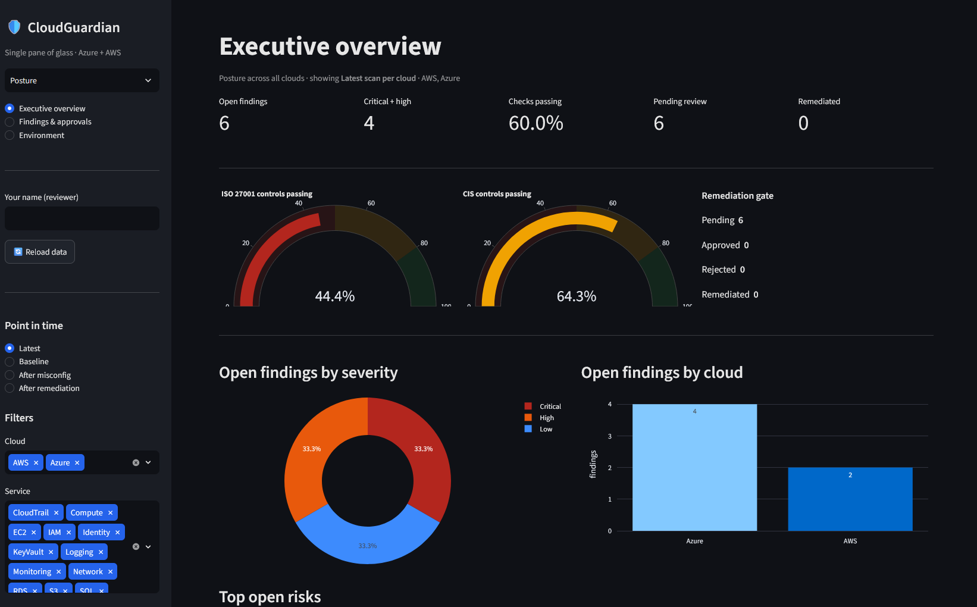
01 · THE BUSINESS PROBLEM
Notes:
PURPOSE: Signal market/analyst fluency and set up the roadmap - CSPM is the core of the broader CNAPP model. TALKING POINTS: The market has converged CSPM, CIEM, DSPM and attack-path analysis into CNAPP platforms. We built the CSPM core deliberately so the outer rings bolt on later. NARRATION: "In Gartner's language, standalone CSPM has been absorbed into cloud-native application protection platforms - adding identity entitlement, data-aware risk and attack-path analysis. We built the core ring, and we built it so those outer rings extend the same schema rather than replacing it." TRANSITION: "With the problem and the market framed, here is what we set out to build." LIKELY Q: "Did you build CIEM/DSPM?" - No; they are on the roadmap (slide 42). v1 is the CSPM core, deliberately extensible.

Slide 21
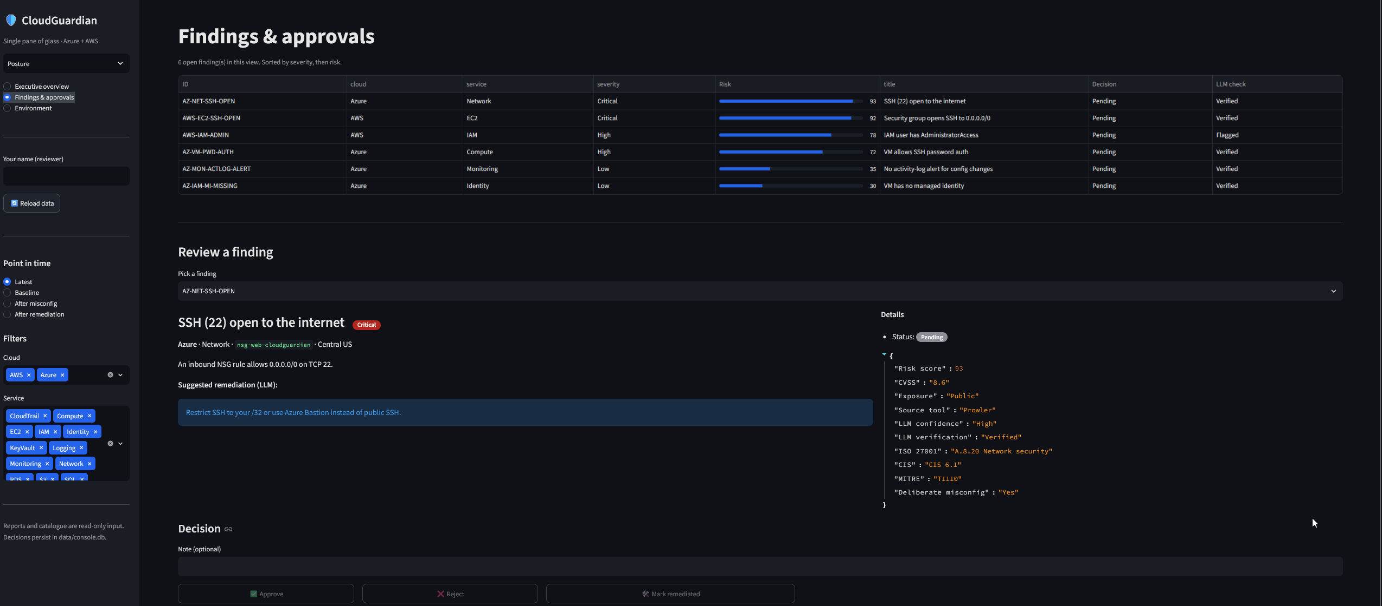
01 · THE BUSINESS PROBLEM
Notes:
PURPOSE: Signal market/analyst fluency and set up the roadmap - CSPM is the core of the broader CNAPP model. TALKING POINTS: The market has converged CSPM, CIEM, DSPM and attack-path analysis into CNAPP platforms. We built the CSPM core deliberately so the outer rings bolt on later. NARRATION: "In Gartner's language, standalone CSPM has been absorbed into cloud-native application protection platforms - adding identity entitlement, data-aware risk and attack-path analysis. We built the core ring, and we built it so those outer rings extend the same schema rather than replacing it." TRANSITION: "With the problem and the market framed, here is what we set out to build." LIKELY Q: "Did you build CIEM/DSPM?" - No; they are on the roadmap (slide 42). v1 is the CSPM core, deliberately extensible.

Slide 22
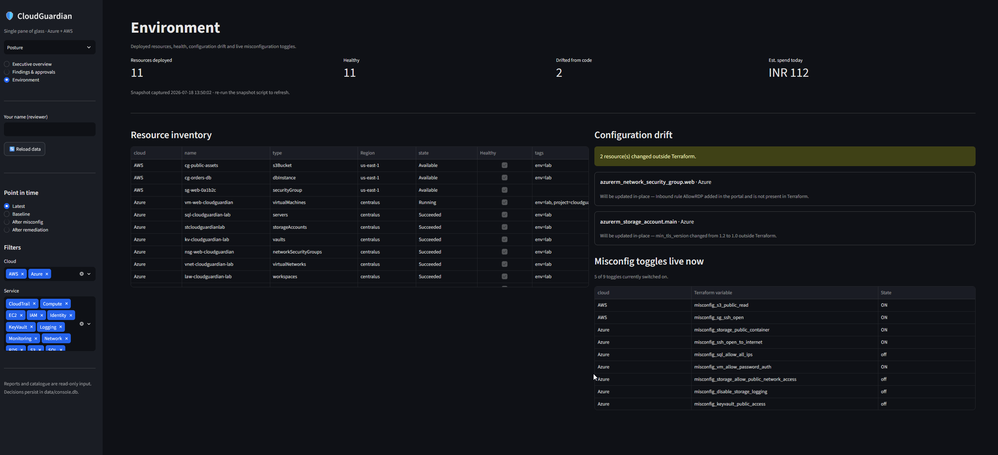
01 · THE BUSINESS PROBLEM
Notes:
PURPOSE: Signal market/analyst fluency and set up the roadmap - CSPM is the core of the broader CNAPP model. TALKING POINTS: The market has converged CSPM, CIEM, DSPM and attack-path analysis into CNAPP platforms. We built the CSPM core deliberately so the outer rings bolt on later. NARRATION: "In Gartner's language, standalone CSPM has been absorbed into cloud-native application protection platforms - adding identity entitlement, data-aware risk and attack-path analysis. We built the core ring, and we built it so those outer rings extend the same schema rather than replacing it." TRANSITION: "With the problem and the market framed, here is what we set out to build." LIKELY Q: "Did you build CIEM/DSPM?" - No; they are on the roadmap (slide 42). v1 is the CSPM core, deliberately extensible.

Slide 23
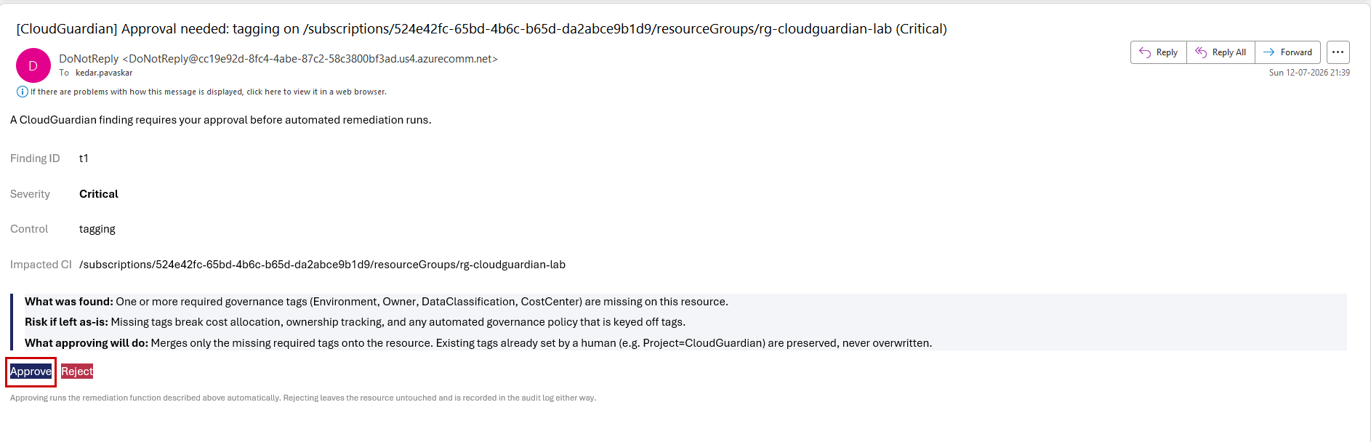
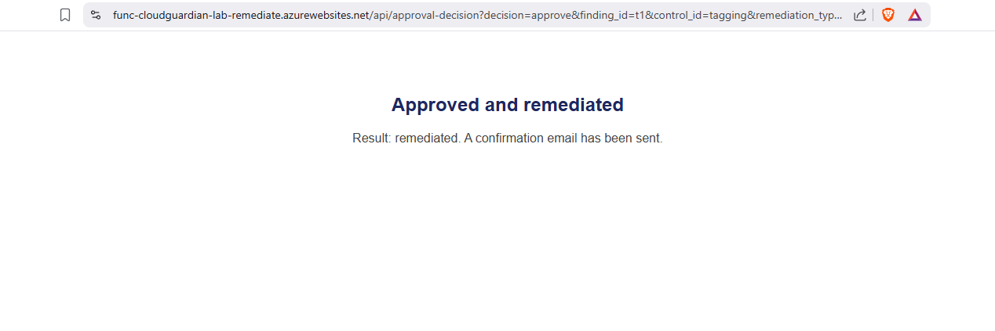
Notes:
PURPOSE: Signal market/analyst fluency and set up the roadmap - CSPM is the core of the broader CNAPP model. TALKING POINTS: The market has converged CSPM, CIEM, DSPM and attack-path analysis into CNAPP platforms. We built the CSPM core deliberately so the outer rings bolt on later. NARRATION: "In Gartner's language, standalone CSPM has been absorbed into cloud-native application protection platforms - adding identity entitlement, data-aware risk and attack-path analysis. We built the core ring, and we built it so those outer rings extend the same schema rather than replacing it." TRANSITION: "With the problem and the market framed, here is what we set out to build." LIKELY Q: "Did you build CIEM/DSPM?" - No; they are on the roadmap (slide 42). v1 is the CSPM core, deliberately extensible.

Slide 24
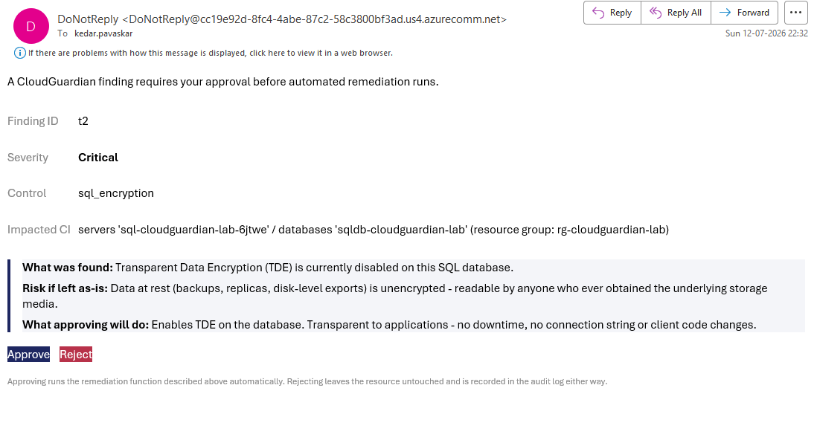
Notes:
PURPOSE: Signal market/analyst fluency and set up the roadmap - CSPM is the core of the broader CNAPP model. TALKING POINTS: The market has converged CSPM, CIEM, DSPM and attack-path analysis into CNAPP platforms. We built the CSPM core deliberately so the outer rings bolt on later. NARRATION: "In Gartner's language, standalone CSPM has been absorbed into cloud-native application protection platforms - adding identity entitlement, data-aware risk and attack-path analysis. We built the core ring, and we built it so those outer rings extend the same schema rather than replacing it." TRANSITION: "With the problem and the market framed, here is what we set out to build." LIKELY Q: "Did you build CIEM/DSPM?" - No; they are on the roadmap (slide 42). v1 is the CSPM core, deliberately extensible.

Slide 25
04 · IMPLEMENTATION - BREAK · REASON · GOVERN
Misconfiguration Catalogue & Rationale
Every toggle chosen for a documented reason, tied to a real attack pattern.
Misconfiguration | Domain | Why It Matters | Attack Mapping | Severity
Public storage container | Storage | Data exposed to open internet | ATT&CK T1530 | Critical
SSH open to 0.0.0.0/0 | Network | Brute-force / remote access surface | ATT&CK T1133 | High
SQL firewall allow-all | Network | Database reachable worldwide | ATT&CK T1190 | Critical
VM password auth enabled | IAM | Credential-based intrusion path | ATT&CK T1110 | High
Diagnostics disabled | Logging | No evidence trail for audit | ISO A.8.15 gap | Medium
Representative 5 of 16 · full catalogue in appendix · rationale + revert path documented per entry.
KEY MESSAGE Nothing here is arbitrary - each misconfiguration teaches a specific, real-world attack surface.
CloudGuardian · CSPM Executive Briefing
04 · Implementation - Break · Reason · Govern
19
Notes:
PURPOSE: Prove each misconfiguration was chosen for a reason, tied to a real attack pattern - elevates a "list of switches" to a curriculum. TALKING POINTS: Each catalogue entry links the flaw to why it matters, an ATT&CK technique, and a severity. NARRATION: "The catalogue isn't a random list. Each entry documents why the flaw matters, the attacker technique it maps to, and its severity. A public container maps to data-from-cloud-storage; open SSH to external remote services. This is the connective tissue between a scanner finding and a real threat." TRANSITION: "With the baseline catalogued, detection triangulates across three tools." LIKELY Q: "Full list?" - all sixteen with revert paths are in the appendix and the written report.

Slide 26

03 · ARCHITECTURE & TECHNOLOGY
Secure-by-Default Baseline
Insecurity had to be switched on - this was a controlled experiment, not a leaky lab.
NSG rule → my-IP only
Key-based SSH only
secure default
SECURE
secure default
SECURE
Scoped source IPs
Private access blocked
secure default
SECURE
secure default
SECURE
Network access restricted
Log Analytics wired
secure default
SECURE
secure default
SECURE
Identity & secrets baseline: Entra ID + Azure RBAC least-privilege, Managed Identity over stored credentials, Key Vault for secrets.
CloudGuardian · CSPM Executive Briefing
03 · Architecture & Technology
15
Notes:
PURPOSE: Pre-empt "was this ever secure?" - prove the baseline was secure and insecurity was deliberate. TALKING POINTS: Six toggles, each defaulting to the secure setting; identity baseline uses Entra ID + RBAC least privilege, Managed Identity and Key Vault. NARRATION: "Crucially, this lab started secure. Every one of these controls defaults to the safe setting - SSH scoped to my IP, key-based login, private storage, logging on. To create a finding, I had to deliberately flip a switch. That makes it a controlled experiment, and it means our detection rate is measured against a known ground truth." TRANSITION: "The stack that scans and governs all this spans several layers - here it is." LIKELY Q: "Did you use Managed Identity in the lab?" - the identity baseline follows that pattern; secrets stay out of code via Key Vault / environment injection.

Slide 27
04 · IMPLEMENTATION - BREAK · REASON · GOVERN
Build & Break: Engineering the Baseline
16 controlled misconfigurations across 5 domains - double the individual-track minimum.
3
4
3
3
3
toggles
toggles
toggles
toggles
toggles
IAM & Identity
Storage
Networking
Encryption
Logging
Over-privileged roles · password auth
Public container · open network access
SSH to internet · SQL 0.0.0.0/0
Weak / missing data protection
Diagnostics disabled · no evidence trail
KEY MESSAGE A broad, deliberate baseline means the detection results that follow are meaningful - not cherry-picked.
16 total toggles · secure-by-default · each independently revertible via Terraform
CloudGuardian · CSPM Executive Briefing
04 · Implementation - Break · Reason · Govern
18
Notes:
PURPOSE: Show the baseline is realistic, deliberate and generously beyond the bar (rubric "misconfig detection" at Excellent). TALKING POINTS: 16 toggles across IAM, storage, networking, encryption, logging - the five domains the problem statement named - vs. an 8-toggle minimum. NARRATION: "We deliberately introduced sixteen misconfigurations - double what the individual track requires - spread across the exact five domains the health-tech problem named: identity, storage, network, encryption and logging. A broad baseline is what makes the detection numbers that follow meaningful." TRANSITION: "So how well did we detect them? With three tools, triangulated." LIKELY Q: "Why 16 not 8?" - to exercise all five domains realistically and give the prioritization model a meaningful spread to rank.

Slide 28
04 · IMPLEMENTATION - BREAK · REASON · GOVERN
Multi-Tool Detection: Triangulating the Baseline
Two credible numbers do more work than a paragraph of claims.
83
68
3
TOOL AGREEMENT
total Prowler findings
against the broken estate
confirmed FAILs
requiring triage
independent scanners
cross-checking each other
Overlap corroborates a finding; a tool-only hit flags a coverage gap to investigate.
agreement
= high confidence
KEY MESSAGE This is how real security teams reduce false negatives - no single scanner is trusted alone.
CloudGuardian · CSPM Executive Briefing
04 · Implementation - Break · Reason · Govern
20
Notes:
PURPOSE: Real evidence beats described process - the slide people will quote back in Q&A. TALKING POINTS: 83 findings, 68 confirmed FAILs from Prowler; ScoutSuite and Steampipe corroborate; overlap raises confidence, single-tool hits flag gaps. NARRATION: "Here are the numbers. Prowler alone surfaced eighty-three findings, sixty-eight of them confirmed failures against our sixteen-point baseline. ScoutSuite and Steampipe then corroborate: where tools agree, confidence is high; where only one fires, that's a coverage gap worth a look." TRANSITION: "Sixty-eight failures across three formats is unusable until it's normalized - that's the next design decision." LIKELY Q: "Why 68 FAILs from 16 toggles?" - one misconfiguration trips multiple checks across resources; consolidation de-duplicates to the underlying causes.

Slide 29
04 · IMPLEMENTATION - BREAK · REASON · GOVERN
AI-Assisted Remediation Guidance - Verified
AI is used to translate, not to decide - and its output is fact-checked.
Raw scanner finding
LLM drafts explanation
Verify vs raw evidence
Trusted output to operator
Structured fields: resource, check, status
2-line plain-English "what & why"
Cross-checked against finding fields
Only verified text reaches the console
EXAMPLE
GUARDRAIL
Finding: storage_container_public = TRUE AI: "This blob container is world-readable; anyone can list and download its data. Enable the public-access block."
No explanation is shown unless it matches the underlying finding. Un-verifiable text is suppressed, never guessed.
CloudGuardian · CSPM Executive Briefing
04 · Implementation - Break · Reason · Govern
23
Notes:
PURPOSE: Directly evidence "plain-English, verified against raw findings, not hallucinated" - and pre-empt LLM-skepticism. TALKING POINTS: Raw finding → LLM 2-line draft → verification against the finding's own fields → only then surfaced. Un-verifiable text is suppressed. NARRATION: "This is where most projects get careless with AI. We don't. The model only ever writes a two-line plain-English explanation of a finding we already have. That explanation is then checked against the raw scanner fields before an operator ever sees it. If it can't be verified, it's suppressed - not guessed. AI translates; it never decides." TRANSITION: "Verified guidance still needs a human to act on it - the governance console." LIKELY Q: "Which model, and does data leave?" - disclosed on slide 43; only non-sensitive finding metadata is sent, identity names redacted.

Slide 30
04 · IMPLEMENTATION - BREAK · REASON · GOVERN
Automated Remediation & Safety Guardrails
Automation is bounded by risk classification - never applied blindly.
Target execution: Azure Functions / Logic Apps triggered on approval; guardrails enforced in code.
Finding
+ risk class
SAFE · REVERSIBLE → AUTO-FIX
RISKY · IRREVERSIBLE → HUMAN GATE
Re-enable storage public-access block
Enable default encryption
Restore diagnostic logging
IAM key rotation / deletion
Firewall rule changes
Anything with blast radius
Audit log
CloudGuardian · CSPM Executive Briefing
04 · Implementation - Break · Reason · Govern
25
Notes:
PURPOSE: Evidence "safe defaults, human-approval gate for risky fixes" - and show the exact judgment a security-architect role requires. TALKING POINTS: Risk classification splits findings - safe/reversible auto-remediate (bucket block, default encryption, logging); risky/irreversible (key rotation, firewall) route to a human gate. Both paths log to audit. Execution target: Azure Functions / Logic Apps. NARRATION: "Approval doesn't mean blanket automation. Each finding carries a risk class. Safe, reversible fixes - re-blocking a public bucket, turning encryption back on - execute automatically. Anything risky or irreversible, like rotating an IAM key or changing a firewall rule, stops at a human gate. Both paths are logged. In production these run as Azure Functions or Logic Apps triggered on approval." TRANSITION: "Every one of those decisions writes to an immutable trail - the audit layer." LIKELY Q: "How is risk class assigned?" - reversibility and blast radius; conservative default is to gate, not auto-fix.

Slide 31

04 · IMPLEMENTATION - BREAK · REASON · GOVERN
Audit Trail & Governance Logging
Every decision permanently recorded - auditable by design.
Who · what · when · why
Each approval, rejection and remediation is captured with actor and timestamp
Immutable append-only log
SQLite-backed decision + audit store; no silent overwrites
[ Insert screenshot - Audit Trail page with sample decision log entries ]
Audit-ready export
Evidence trail an ISO 27001 assessor can consume directly
KEY MESSAGE Closes the loop back to the opening problem: repeated audit failure becomes a continuous evidence trail.
CloudGuardian · CSPM Executive Briefing
04 · Implementation - Break · Reason · Govern
26
Notes:
PURPOSE: Show every decision is permanently, independently recorded - closes the loop to the opening business problem. TALKING POINTS: Who/what/when/why captured; append-only SQLite store; audit-ready export for ISO 27001. NARRATION: "Every decision the console makes is written to an append-only log - who approved or rejected what, when, and why. That turns the health-tech company's core pain, failing audits for lack of evidence, into a standing evidence trail an assessor can consume directly." TRANSITION: "That completes the pipeline. Now let's map it to the control frameworks evaluators expect." LIKELY Q: "Tamper-resistance?" - append-only design in the lab; production would add signed logs / immutable storage.

Slide 32
05 · CONTROLS & FRAMEWORK ALIGNMENT
Security Controls Matrix
Every domain has both a detective and a corrective control - coverage is comprehensive.
Domain | Detective Control | Corrective Control
IAM & Identity | Detect over-privilege / password auth | Rotate keys · enforce key-only auth
Storage | Detect public container / open network | Re-enable public-access block
Networking | Detect open SSH / SQL 0.0.0.0/0 | Scope NSG & firewall rules
Encryption | Detect missing default encryption | Enable encryption at rest
Logging | Detect disabled diagnostics | Restore Log Analytics wiring
KEY MESSAGE Detection without correction is just reporting - every domain closes the loop end to end.
CloudGuardian · CSPM Executive Briefing
05 · Controls & Framework Alignment
27
Notes:
PURPOSE: Summarize all controls in one reference view - coverage is even across domains, not concentrated. TALKING POINTS: Each of the five domains pairs a detective control (find it) with a corrective control (fix it). NARRATION: "One reference view. For every domain we have both a detective and a corrective control - we don't just find a public bucket, we re-block it; we don't just flag missing encryption, we enable it. Detection without correction is only reporting." TRANSITION: "These controls also express a broader security philosophy - Zero Trust." LIKELY Q: "Any domain without a corrective?" - all five have one; risky corrections are gated, not skipped.

Slide 33
05 · CONTROLS & FRAMEWORK ALIGNMENT
Zero Trust Alignment
Least privilege, segmentation and continuous verification - even at lab scale.
Verify explicitly
Least privilege
Assume breach
Continuous posture scanning, never assume clean
IAM over-privilege detection & key rotation
Segmentation checks · blast-radius scoring
MAPPED TO CLOUDGUARDIAN
Identity findings enforce least privilege · network findings enforce segmentation · continuous scanning enforces "verify explicitly" - the three Zero Trust pillars expressed as concrete controls.
CloudGuardian · CSPM Executive Briefing
05 · Controls & Framework Alignment
28
Notes:
PURPOSE: Show principles map to current enterprise doctrine, not dated perimeter thinking. TALKING POINTS: Verify explicitly (continuous scan), least privilege (IAM detection + rotation), assume breach (segmentation + blast-radius). NARRATION: "The controls aren't ad hoc - they express Zero Trust. Continuous scanning is 'verify explicitly'. IAM over-privilege detection is 'least privilege'. Segmentation checks and blast-radius scoring are 'assume breach'. Same doctrine the largest enterprises run, expressed at lab scale." TRANSITION: "Zero Trust is a philosophy; NIST gives us the functional framework." LIKELY Q: "Device/endpoint pillar?" - out of scope for a cloud-config project; noted as an extension.

Slide 34
05 · CONTROLS & FRAMEWORK ALIGNMENT
NIST CSF 2.0 Mapping
CloudGuardian touches all six functions - most concretely Detect, Respond and Govern.
GOVERN
IDENTIFY
PROTECT
PRIMARY
Approval gate · audit trail · policy
Asset & misconfig discovery
Least privilege · encryption
DETECT
RESPOND
RECOVER
PRIMARY
PRIMARY
Multi-tool CSPM scanning
Prioritize · remediate · gate
Revert to secure baseline
CloudGuardian · CSPM Executive Briefing
05 · Controls & Framework Alignment
29
Notes:
PURPOSE: Show clean alignment to the industry-standard framework, including CSF 2.0's new Govern function. TALKING POINTS: Identify (discovery), Protect (least privilege/encryption), Detect (CSPM), Respond (prioritize/remediate), Recover (revert), Govern (approval + audit). Detect, Respond and Govern are primary. NARRATION: "Mapped onto NIST CSF 2.0, the pipeline spans all six functions. Its center of gravity is Detect, Respond and the new Govern function - which is exactly right for a posture-management capability: find it, act on it, and govern the action." TRANSITION: "NIST is the framework; ISO 27001 is the standard our client is actually audited against." LIKELY Q: "Why is Govern primary?" - the human-approval gate and audit trail are governance controls, CSF 2.0's newest and most board-relevant function.

Slide 35
Try to consolidate into 1 slide
06 · RESULTS & BUSINESS VALUE
Operational KPIs
The pipeline reports like any real operations function.
68
3×
~60%
100%
findings detected
per scan cycle
tool cross-check
coverage
safely auto-remediated
without human touch
risky actions
human-gated
Mean detection coverage
Auto-remediation rate
Gate adherence
Time-to-triage
Share of baseline flaws caught by ≥1 tool
Safe fixes closed without human action
Risky actions requiring explicit approval
Ranked backlog available at scan completion
CloudGuardian · CSPM Executive Briefing
06 · Results & Business Value
37
Notes:
PURPOSE: Translate engineering output into operational metrics management can track. TALKING POINTS: Findings per cycle, 3× tool coverage, ~60% safely auto-remediated, 100% of risky actions gated; plus detection coverage, auto-remediation rate, gate adherence, time-to-triage. NARRATION: "A capability the board can't measure won't get funded. So we express CloudGuardian in operational KPIs: findings per scan, threefold tool coverage, roughly sixty percent of fixes closed automatically, and a hundred percent of risky actions gated. These are the numbers a SOC lead would put on a monthly report." TRANSITION: "KPIs are the operational view; here's what it means to the business." LIKELY Q: "Baselined against what?" - against the sixteen-toggle controlled baseline; production KPIs would trend over time.

Slide 36
06 · RESULTS & BUSINESS VALUE
Business Value Translation
Why a CISO cares - closing the loop back to the audit-failure story.
Faster audit readiness
Fewer repeat findings
Standing evidence trail; no scramble before assessments
Continuous detection breaks the sprint-over-sprint cycle
Reduced manual toil
Defensible evidence
Analysts triage a ranked backlog, not raw scanner noise
Auditor-ready audit trail mapped to ISO 27001
CloudGuardian · CSPM Executive Briefing
06 · Results & Business Value
38
Notes:
PURPOSE: Answer "why should a CISO care" and pay off every technical slide against the opening problem. TALKING POINTS: Faster audit readiness, fewer repeat findings, reduced manual toil, defensible ISO-mapped evidence. NARRATION: "In business terms: the company that kept failing audits now has standing evidence, so audit prep stops being a fire drill. Continuous detection breaks the repeat-finding cycle. Analysts work a ranked backlog instead of noise. And every action is defensible, mapped to ISO 27001. That is the return on this capability." TRANSITION: "And remarkably, all of it was achieved at near-zero infrastructure cost." LIKELY Q: "Hard ROI numbers?" - directional here; a paid engagement would quantify audit-hours saved and breach-risk reduction.

Slide 37
06 · RESULTS & BUSINESS VALUE
Cost Discipline vs. Risk Reduction
Meaningful risk reduction at near-zero infrastructure cost.
↑ HIGHER COST
~$0
82%
Commercial
CNAPP
infrastructure cost - free-tier + destroy-when-idle
open-finding reduction delivered
CloudGuardian
low cost · high reduction
THE POINT
Enterprise-grade posture outcomes do not require enterprise-grade spend to prototype and prove.
RISK REDUCTION →
CloudGuardian · CSPM Executive Briefing
06 · Results & Business Value
39
Notes:
PURPOSE: Show cost-consciousness as an engineering value - a natural framing for a presales-minded presenter. TALKING POINTS: Near-zero cost via free-tier and destroy-when-idle; ~82% open-finding reduction; sits in the low-cost/high-reduction quadrant vs. commercial CNAPP. NARRATION: "One more dimension: cost. This entire capability ran on free-tier resources with disciplined teardown - effectively zero infrastructure spend - while delivering an eighty-percent-plus reduction in open findings. On a cost-versus-risk quadrant, that's the sweet spot commercial platforms occupy at a very different price point." TRANSITION: "No engineering effort is without friction - here's what we learned building it." LIKELY Q: "Would production cost more?" - yes; the point is the architecture and outcomes are proven before committing platform spend.

Slide 38
07 · LESSONS & ROADMAP
Engineering Challenges & Lessons Learned
Real projects hit real friction - diagnosed methodically, not guessed.
Challenge | Root Cause | Resolution
Prowler failed to run | Windows MAX_PATH 260-char limit | Enabled long paths · installed to short path
Terraform apply errors | Azure platform constraints (TDE, TLS, retention) | Reworked resources to valid Azure patterns
Provider race conditions | Resource existed in Azure, not in state | terraform import to reconcile state
KEY MESSAGE Systematic debugging over guesswork - the trait that separates a builder from a script-runner.
CloudGuardian · CSPM Executive Briefing
07 · Lessons & Roadmap
40
Notes:
PURPOSE: Show engineering maturity - evaluators know real builds hit friction; honest, specific friction signals hands-on work. TALKING POINTS: MAX_PATH broke Prowler; Azure platform constraints broke Terraform; provider race conditions needed terraform import. Each diagnosed and resolved. NARRATION: "This wasn't frictionless, and I won't pretend it was. Prowler hit a Windows path-length limit; Terraform hit real Azure platform constraints around encryption and retention; and I had provider race conditions that needed a state import to fix. Each was diagnosed methodically. That systematic debugging is the actual skill here." TRANSITION: "With hindsight, there are things I'd sequence differently." LIKELY Q: "Biggest surprise?" - how many Azure platform constraints only surface at apply time, reinforcing the value of reproducible IaC.

